Slide 1


what is configuration file?
How to start mongod.exe using configuration file?
What is log file and how to define logpath?

Slide 2
MongoDB CRUD Operations

Slide 3
MongoDB CRUD
Insert Operation
Read Operation
Update Operation
Remove Operation

Slide 4
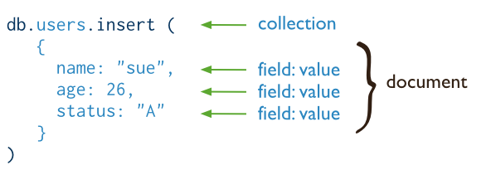
Insert Operation
In MongoDB, the db.collection.insert() method adds new documents to a collection.
Syntax:-

Slide 5
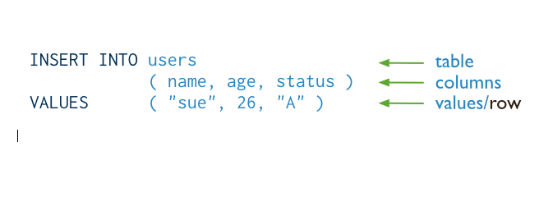
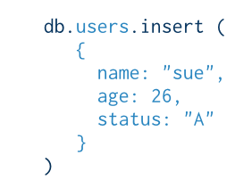
SQL vs MongoDB Insert
The following diagram shows insert query in SQL:
The following diagram shows the same query in mongodb:
Database

Slide 6
Insert Behavior
If you add a new document without the _id field, the client library or the mongod instance adds an _id field and populates the field with a unique ObjectId.
If you specify the _id field, the value must be unique within the collection.
For operations with write concern, if you try to create a document with a duplicate _id value, mongod returns a duplicate key exception.

Slide 7
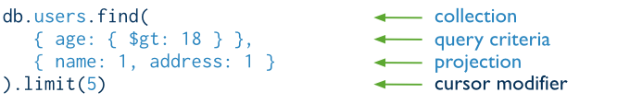
Read Operations
In MongoDB, the db.collection.find() method read documents to a collection.
Syntax:-
Database

Slide 8
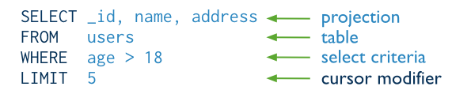
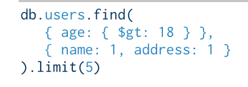
SQL vs MongoDB Read
The following diagram shows insert query in SQL:
The following diagram shows the same query in mongodb:
Database

Slide 9
Query Behavior
MongoDB queries exhibit the following behavior:
All queries in MongoDB address a single collection.
You can modify the query to impose limits, skips, and sort orders.
The order of documents returned by a query is not defined unless you specify a sort()

Slide 10
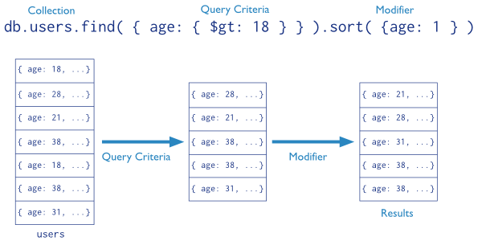
Query Statements
Database

Slide 11
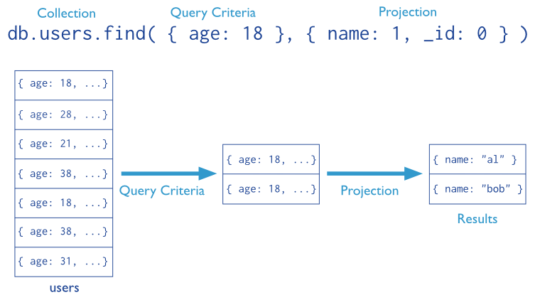
Projections

Slide 12
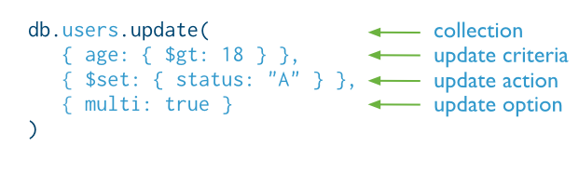
Update Operation
In MongoDB, the db.collection.update() method modifies existing documents in a collection.
Syntax:-
Database

Slide 13

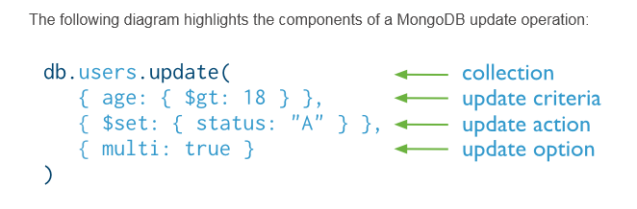
SQL vs MongoDB Update

Slide 14
Update Behavior
By default, the db.collection.update() method updates a single document.
To update multiple document use “multi: true” options in update
Eg:-
db.books.update( { age: 25 }, {name : “jack” }, {multi:true})
Notes:
Flexible schema
Javascript

Slide 15
Update with Upsert
If upsert is true and no document matches the query criteria, update() inserts a single
Eg:-
    db.people.update(
    { name: "Andy" },
    {
    name: "Andy",
    rating: 1,
    score: 1
    },
    { upsert: true }
)
Database

Slide 16
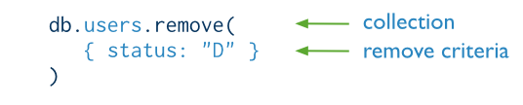
Remove Operations
In MongoDB, the db.collection.remove() method removes existing documents in a collection.
Syntax:-
Database

Slide 17

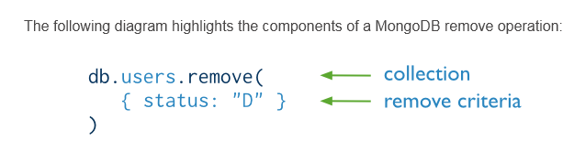
SQL vs MongoDB Remove

Slide 18
Remove Behavior
By default, db.collection.remove() method removes all documents that match its query.
However, the method can accept a flag to limit the delete operation to a single document.
Database

Slide 19

What is findOne? How to use it ?
What is pretty() ?
What is save()?
Difference between save() and update() ?

